Slide 1
Intermediate Analytics ALY6015 Lecture 2: Inferential Statistics: Hypothesis Testing and Regression Analyses

Slide 2

Administrative Notes
Discussion Comments
Final Project
Data Set Selection Assignment
Group Formation (due 11:59 PM Sunday 4/19)

Slide 3
Course Tracker
Descriptive statistics in R (Week 1)
Graphical representation of data in R (Week 1)
Inferential statistics in R (TODAY)
Hypothesis testing (TODAY)
Regression Analysis (TODAY)
Regularization and Lasso Modeling (Week 3)
Data Mining (Week 4)
Clustering and Classification (Week 4)
Time Series Forecasting (Week 5)
Bringing it all together – Group Project (Week 6)

Slide 4
Lecture Part 1 Inferential Statistics and Hypothesis Testing in R

Slide 5
Descriptive vs. Inferential Statistics
Type
Description
Descriptive Statistics
Week 1 Focus
Collecting, organizing, summarizing, and presenting data – including calculating various properties of the data and graphing those properties
Inferential Statistics
Week 2 Focus
Applying statistical models to sample data to make inferences, calculate confidence intervals, and make predictions – including hypothesis testing and regression

Slide 6
Inferential Statistics
Definition
What Does Inference Enable?
Inferential statistics are concerned with making inferences based on relations found in the sample, to relations in the population
Inferential statistics help us decide, for example, whether the differences between groups that we see in our data are strong enough to provide support for our hypothesis that group differences exist in general, in the entire population
Model Building: Develop statistical models that explain the relationships between a dependent variable (output) and one or more independent variables (inputs), enabling prediction of the dependent variable when presented with any given sets of independent variables
Hypothesis testing: Drawing inferences about two contrasting propositions (each called a hypothesis) relating to the value of one or more population parameters

Slide 7
Samples & Populations
Populations are indefinitely large (or perhaps infinite) sets of observations.
Parameters = descriptive measures of a population
Samples are subsets of a population.
Statistics = descriptive measures of a sample
Random sample – drawn so that each member of the population has an equal and independent chance of being included in the sample.
We want to make inferences from a sample to a population.

Slide 8
Review - Samples & Populations
Parameters represent characteristics of populations
Parameters
μ, σ, ρ
Population
A sample is drawn from a population
Parameters are estimated from statistics
Statistics
X, s, r
Sample
Statistics are characteristics of samples
Notes:
And this is what we do all the time. We select samples from populations, compute statistics that tell us the story of the samples and then we want to extrapolate the story to the population, in other words we want to make inferences about a population.
But because we do not really have information about the population our inferences or statements are made with a specified probability of being correct (or incorrect).

Slide 9
Inference, Populations and Samples
In many cases we want to understand populations, be able to describe them in terms of means, standard deviations, etc. = parameters (μ, σ)
This turns out to be way too expensive in most cases so we have to deal with samples and sample statistics ( ,s)
Let’s say we have a very large population – let’s say adults (age>21) in the United States and we want to know what the average height in the US is. Can we measure all people in the US? Unlikely! So, we would take a sample.

Slide 10
Measurement, Variables, and Inferential Statistics
Measurement
What are we measuring?
What are the units of measurement?
What is the error of measurement?
Variables: nominal, ordinal, interval, ratio.

Slide 11
Hypothesis Testing
In hypothesis testing, we are trying to determine if there is a meaningful difference between a sample of data we have collected versus a population of which we know the parameters
Many tests seek to answer how confident are we that a sample comes from the same population as in our hypothesis, or a different population
Method
Develop a null hypothesis (H₀) and an alternative hypothesis (H₁ or H_{A})
Null hypothesis: describes an existing theory – often that samples are from the same population
Alternative hypothesis: the complement of H₀
Using sample data, we either:
Reject H₀ and conclude the sample data provides sufficient evidence to support H₁
Fail to reject H₀ and conclude the sample data does not support H₁

Slide 12
Common Tests
Directional Hypothesis: One-Tailed Test
If the hypothesis has a direction, it requires a one-tailed test. It has a direction if the hypothesis is stated as:
H₀ : parameter ≥ constant; H₁ : parameter < constant
Or H₀ : parameter ≤ constant; H₁ : parameter > constant
Non-Directional Hypothesis: Two-Tailed Test
If the hypothesis has no direction, it requires a two-tailed test. It has no direction if the hypothesis is stated as:
H₀ : parameter = constant
H₁ : parameter ≠ constant

Slide 13
Determine Proper Form of Hypothesis Test
Hypothesis testing always assumes that H₀ is true and uses sample data to determine whether H₁ is more likely to be true.
Statistically, we cannot “prove” that H₀ is true; we can only fail to reject it.
Rejecting the null hypothesis provides strong evidence (in a statistical sense) that the null hypothesis is not true and that the alternative hypothesis is true.
Therefore, what we wish to provide evidence for statistically should be identified as the alternative hypothesis.

Slide 14
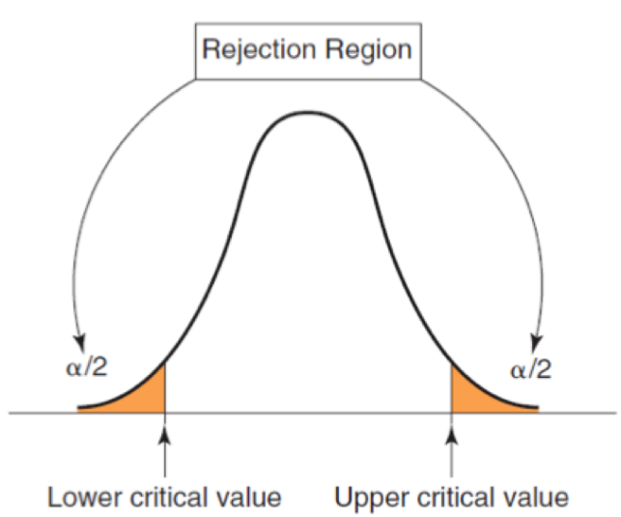
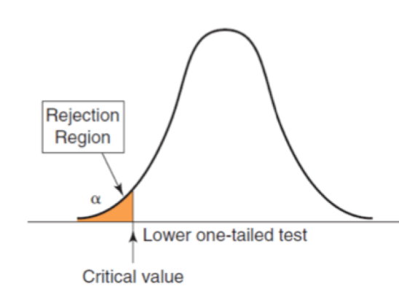
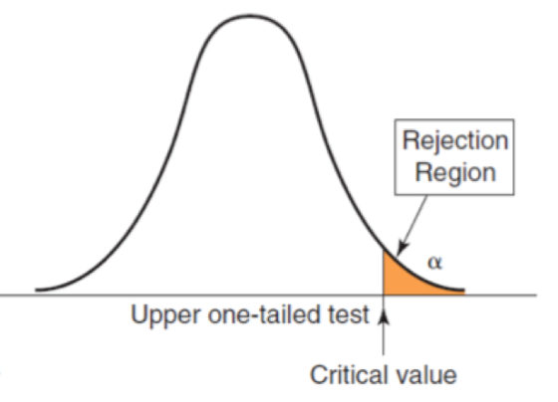
Critical Value and Rejection Regions
The conclusion to reject or fail to reject H₀ is based on comparing the value of the test statistic to a critical value from the sampling distribution of the test statistic when the null hypothesis is true and the chosen level of significance, α.
The sampling distribution of the test statistic is usually the normal distribution, t-distribution, or some other well-known distribution
The critical value divides the sampling distribution into two parts, a rejection region and a non-rejection region. If the test statistic falls into the rejection region, we reject the H₀; otherwise, we fail to reject it.
Two-Sided Test
One-Sided Tests

Slide 15
Hypothesis Testing Procedure
Identify the population parameter and formulate the hypotheses to test. This is where you decide if it is one-tailed (directional) or two-tailed (non directional) test.
Select a level of significance, alpha level (i.e. the risk of drawing an incorrect conclusion). This is the probability value that is used to define the very unlikely sample outcomes if Null is true.
For two-tailed test: find the critical regions. For alpha = 0.05, in two-tailed test, critical region will be z = -/+ 1.96.
For one-tailed test: the critical region is in one tail (the direction of the hypothesis)
Collect data and compute sample statistic
Make a decision and draw a conclusion: compare the obtained sample data with the prediction from the hypothesis.

Slide 16
Step 1 for One-Tailed Test: Example
Company X receives calls for technical support. In the past, the average ticket resolution has been 25 minutes. Company X believes that the use of the new customer service software could reduce the average ticket resolution time below the current average rate of 25 minutes.
If the new software makes a difference, the data will confirm that the average resolution time is less than 25 minutes; this defines the alternative hypothesis, H₁
H₀: mean resolution time ≥ 25 minutes
H₁ : mean resolution time < 25 minutes

Slide 17
Step 2: Set level of significance
In the Company X example, let's set α = 0.05 and perform a one-tailed test.
H₀: mean resolution time ≥ 25
H₁ : mean resolution time < 25
If we were doing a two-sample t-test, it would look like this instead
Company X vs. Company Y; we want to prove Company Y call times are different.
H_0: (time_Y – time_X) ≥ 0
H_1: (time_X – time_Y) < 0

Slide 18
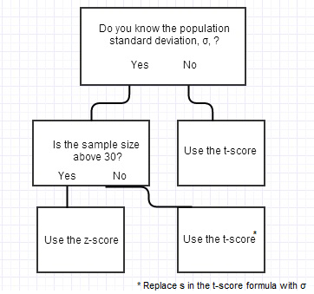
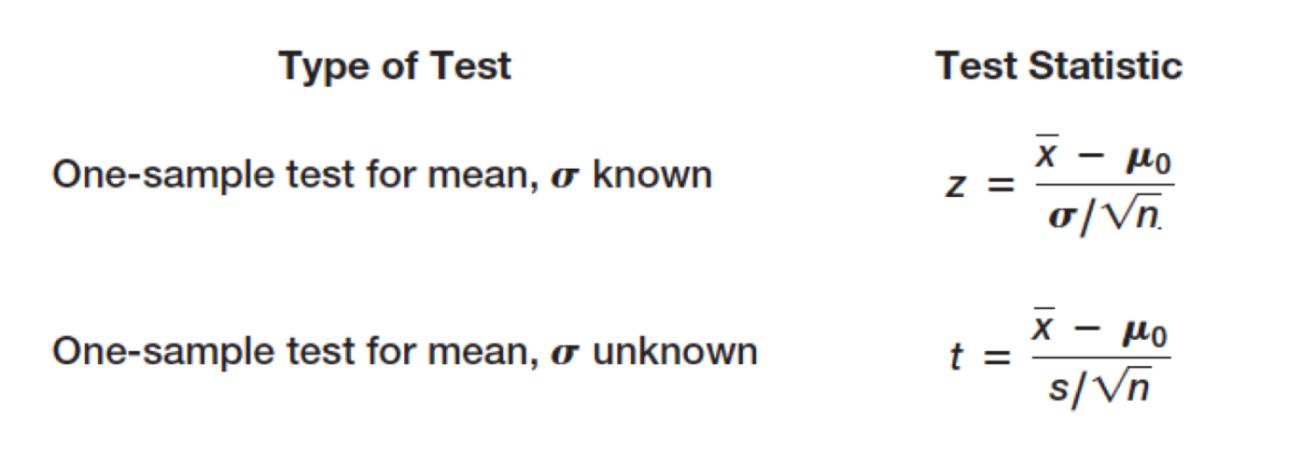
Step 3a: z vs. t Sample Statistic
The decision to reject or fail to reject a null hypothesis is based on computing a test statistic from the sample data. The test statistic used depends on the type of the hypothesis test.
Test statistics for one-sample hypothesis tests for means:
In the Company X example, sample size was 44 and the mean resolution time turned out to be 21.91 minutes with a sample standard deviation of 19.49 minutes. Calculate the t statistic (t because we do not know the population mean).
t = -1.05, which indicates that the sample mean of 21.91 is -1.05 standard errors below the hypothesized mean of 25 minutes.

Slide 19
Step 3b: Calculate Sample Statistic
If n = 44, df =n−1 = 43, t = -1.05, α = 0.05, confidence interval = 0.95
Then, using T Table (or qt function in R), we can see that our critical value or significance level ≥ |1.68|

Slide 20
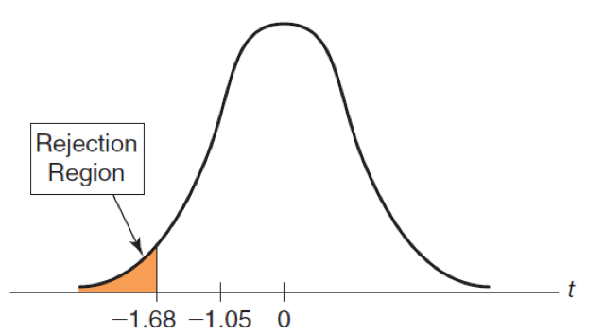
Step 4: Make a decision and draw a conclusion
Hence, t = -1.05 does not fall in the rejection region, thus, we fail to reject H₀.

Slide 21
Type I and Type II errors
H₀ is true and the test correctly fails to reject H₀
H₀ is false and the test correctly rejects H₀
H₀ is true and the test incorrectly rejects H₀ (Type I error)
H₀ is false and the test incorrectly fails to reject H₀ (Type II error)
H₀ is True
H₀ is False
True Situation
Possible Decisions
Retain H₀
Correct
(1-α)
Type II Error
(β)
Reject H₀
Type I Error
(α)
Correct Decision
(Power=1-β)
Notes:
We generate null hypotheses in which we postulate that yes, a sample does belong to a hypothesized situation (or two samples come from two identical populations in case II research). We also generate alternative hypothesis in which we say the contrary. Our goal in general is to check if the null hypothesis is true so we assume it is true and go on checking.
We establish a level of significance alpha. In other words we allow for the possibility of making a type I error equal to alpha. In general alpha is set at .01, 05 or even .1 in social science research. In medical research it might be set at .0001 because making an error comes with more serious consequences.
For example, if we want to decide if a new curriculum is better than the existing one we can assume a .05=5% risk of rejecting H0 even if it is true and students would continue to use the old curriculum if we wrongly reject H0.
However, in medical research we may want to be a lot more careful about what probability of being wrong we want to assume.
Since we rarely if ever can measure things exactly in the social sciences we talk about probabilities. Since probabilities have a lot to do with hypothesis testing, the normal curve, etc we will review probabilities in some detail.

Slide 22
Type I and Type II errors
The null hypothesis is rejected if the p-value is less than a predetermined level, α.
The probability of making a Type I error is equal to α (level of significance) = P(rejecting H₀ | H₀ is true)
The value of 1 – α is called the confidence coefficient = P(not rejecting H₀ | H₀ is true) or accurately not rejecting H₀.
The value of α can be controlled. Common values are 0.01, 0.05, or 0.10.
The probability of making a Type II error = β = P(not rejecting H₀ | H₀ is false)
The value of 1 - β is called the power of the test = P(rejecting H₀ | H₀ is false) or accurately rejecting H₀.
The value of β cannot be specified in advance and depends on the value of the (unknown) population parameter.

Slide 23
Purpose of Alpha Level
Determines the probability of Type I error
When alpha = 0.05, Type I error occurs 5% of the time
Has four main implications:
Alpha increases -> P(Type I error) increases
Alpha increases -> P(Type II error) decreases
Alpha increases -> size of critical region increases
Alpha increases -> difficulty of rejecting H₀ decreases

Slide 24
p-value
Is the measure of statistical significance. The p-value is used as an alternative to rejection points to provide the smallest level of significance at which the null hypothesis would be rejected.
We can consider a result statistically significant only when the p-value is less that the pre-determined statistical significance level, alpha

Slide 25
How β Depends on the True Population Mean
In the call center example:
* H₀: mean response time ≥ 25
* H₁: mean response time < 25
If the true mean is 15, then the sample mean will most likely be less than 25, leading us to reject H₀.
If the true mean is 24, then the sample mean may or may not be less than 25, and we would have a higher chance of failing to reject H₀.
The further away the true mean is from the hypothesized value, the smaller the value of β, hence, the smaller the chance of not rejecting H₀ when it is in fact false.
Generally, as α decreases, β increases
We want the power of the test to be high and the probability of a Type II error to be low, to allow us to make a valid conclusion.
The power of the test is sensitive to the sample size; small sample sizes generally result in a low value of 1 - β. Large sample size enable us to detect small differences between the sample statistics and population parameters with more accuracy.

Slide 26
Comparing Two Samples
Independent Measures Research or Between-Subject Design
Until now we were looking into analyses using one sample of data. What if we want to compare two groups? The goal is to evaluate the differences between two unknown populations.
For two-tailed test, the hypothesis here states a comparison of either no mean difference between the two samples (H₀ ) or a mean difference (H₁ )
How about paired studies? How about comparing proportions?

Slide 27
ANOVA (Analysis of Variance)
Analysis of variance (ANOVA) can determine whether the means of three or more groups are different. ANOVA uses F-tests to statistically test the equality of means
The F-statistic is the test statistic for F-tests. In general, an F-statistic is a ratio of two quantities that are expected to be roughly equal under the null hypothesis, which produces an F-statistic of approximately 1.
F = variation between sample means / variation within the samples
For example, we want to evaluate the effects of 4 different drugs on participants level of depression. An ANOVA allows us to quantify how far apart the sample means must be before we are no longer willing to say they are all approximately equal.
There are many differences between ANOVA and t-test but the main one is that ANOVA is used to compare multiple (two or more) groups/treatments.
ANOVA can be single factor (IV) and level (variation)
ANOVA can be multiple factor (IVs) and levels (variations)
ANOVA can look into between treatment variability (measures difference due to treatment vs chance) and within treatment variability (measures difference due to chance)

Slide 28
Lecture Part 2 Regression in R

Slide 29
Regarding Statistical Models
We want to build models to find the relationship between variables in sample data, in order to generalize to the population.
“Essentially, all models are wrong, but some are useful’” – George Box
Useful models based on sample data “explain” the maximal amount of variance when applied to the population
Deterministic data can be generalized based on an equation – but this is not where inference is powerful
Example: Fahrenheit = 32 + 1.8 * Celsius
Non-deterministic data has inherent variance – need to build a model to try to “explain” as much variance as possible
Y = Bx + C + error
Example: Predicting children’s height based on parents’ height
This model is no longer deterministic and allows for errors of prediction

Slide 30
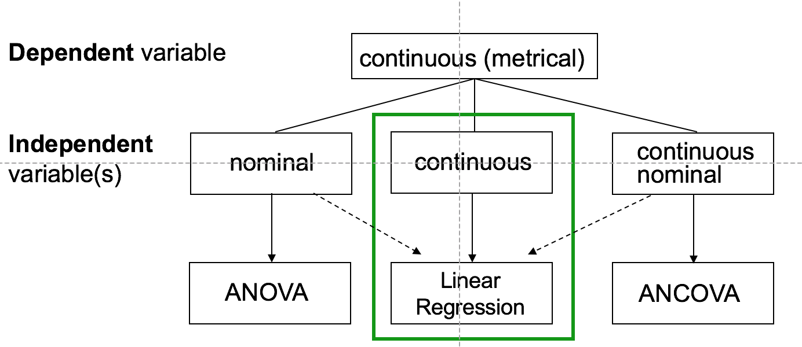
Regression: Simple Linear Regression (GLM)
Used primarily to map continuous IV(s) to a continuous DV

Slide 31
The Goal of Linear Regression
Linear regression is a simple approach to supervised learning. It's goal is predicting a continuous dependent variable (Y) from one or more independent variables (X₁, X₂, ... X_{n})
Linear regression assumes that the dependence of Y on X₁, X₂, ... X_{n} is linear.

Slide 32
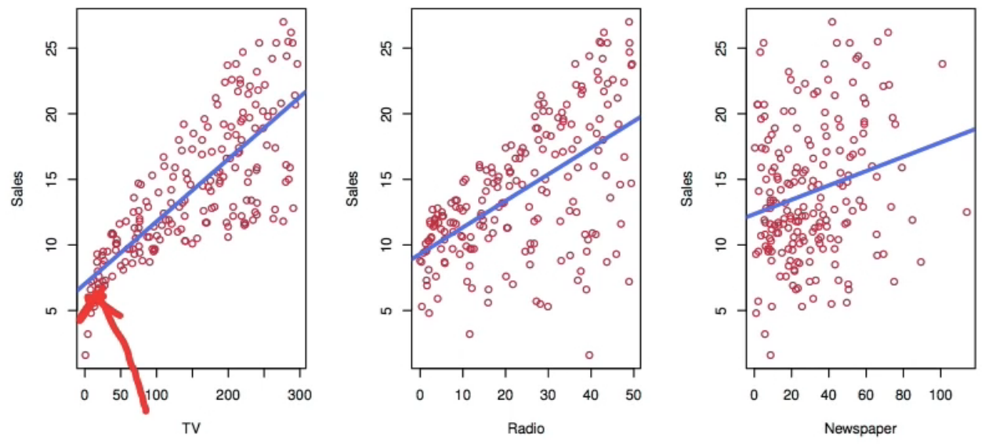
The Use of Linear Regression
While true regression functions are never linear, simple linear regression is very useful as using it we can tell:
Is there a relationship between Y (sales) and X (advertising budget)?
How strong is the relationship?
Is the relationship linear?
How accurately can we predict future sales?
Which X (TV, Radio, Newspaper) contributes the most to Y?

Slide 33
Simple (bivariate) Linear Regression Model
Defined by the equation Y = a + bX
where Y and X are the variables, a and b are the coefficients/constants that represent the intercept in the slope.
Example: Temperature in Celsius (°C) can be converted into Fahrenheit (°F) using this equation:
°F = 32 + 1.8 °C,
Y = °F, X = °C, a = 32, and b = 1.8

Slide 34
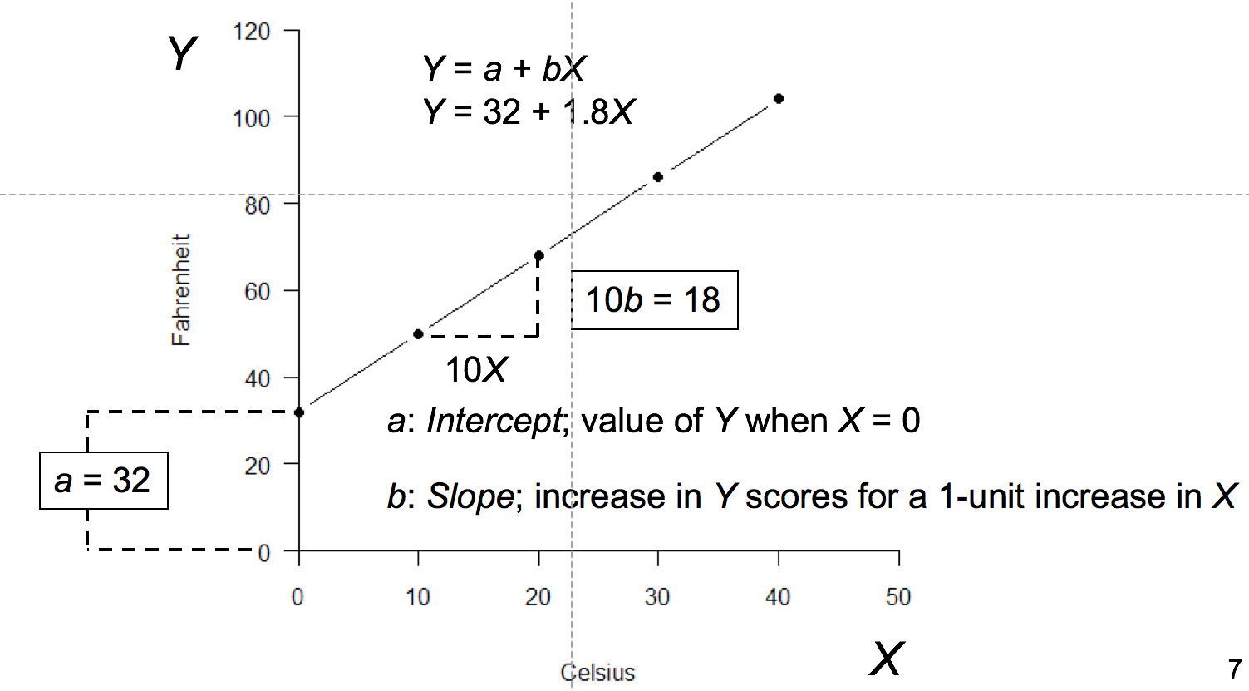
Slope and Intercept

Slide 35
Non-Deterministic Relationship Example
In a more realistic example, the data points would be scattered around the line. Few, if any, points would fall exactly on the line. This means, a simple linear equation cannot perfectly predict exam scores from homework scores for example—even though there is a strong positive correlation.
The reason is that there is measurement error in X and Y plus other IVs not considered in the model. Hence, we add an error variable epsilon, ε, to the equation, which is the error of measuring Y from X:
Y = a + bX + ε
This model is no longer deterministic and it allows for errors of prediction

Slide 36
Predicting Future Values
This is the equation for the predicted value of Y, using the estimates of a and b.
ŷ = â̂ + b̂ X,
where ŷ is the estimated/predicted value of Y and â̂ and b̂ are the estimates for the coefficients. So how do we estimate a and b?

Slide 37
Estimating the Regression Coefficients (a and b)
To find the best fitting values for the coefficients, we look into the residual. Residual is the discrepancy between the actual outcome and the predicted outcome (the fit). We want the residuals to be small. Since the residual can be either negative or positive, we square residuals, because working with absolute values is more difficult.
Sum of squared errors (SSE) is the sum of all squared errors for each observation. So we choose the values of the coefficients so the SSE is as small as possible, thus, the line fit is as close as possible:
SSE = ε₁² + ε₂² + ... + ε_{n}²
SSE = sum(Y_{i}– a – bX_{i}) ²

Slide 38
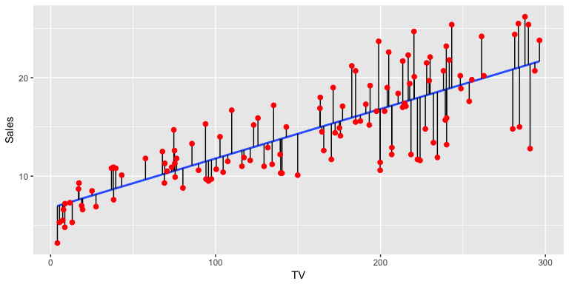
Estimate Fit
In this image, the red dots (the residuals) is the residual distance of the point from the line. So when we square these and sum them, we want that result (SSR) to be as small as possible, so the least squares line is as close to the points as possible. So for this, we need to estimate a and b as accurately as possible.

Slide 39
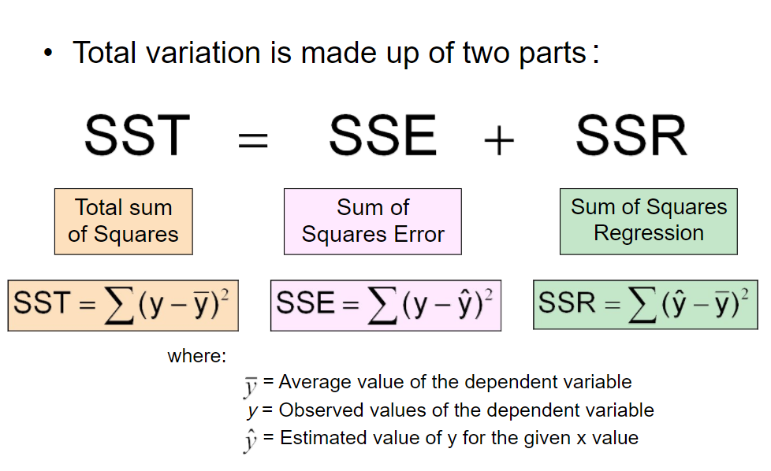
Total Variation

Slide 40
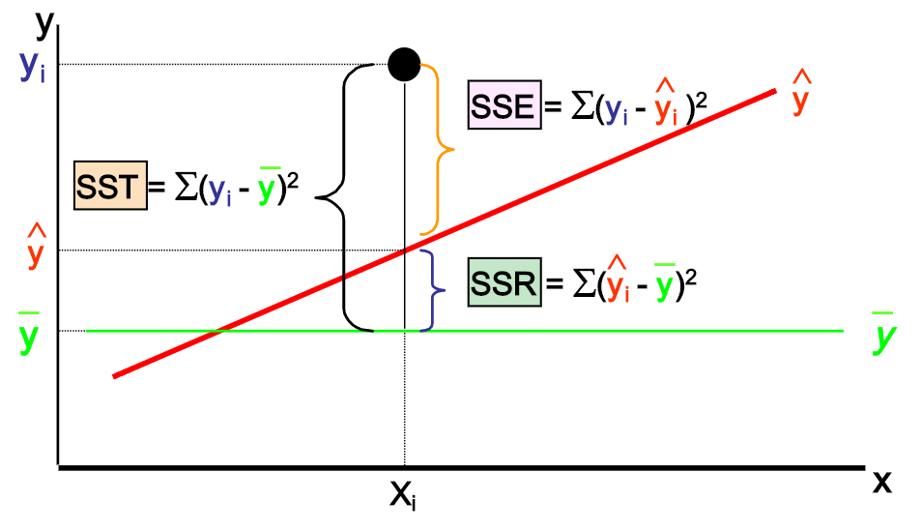
Total Variation

Slide 41
Estimating Coefficients
b (slope) = Cov(yx)/Var(X)
a (intercept) = ŷ - b̂X,
where Cov(yx) is the covariance of X and Y
Var(X) is the variance of X
Naturally, you wouldn't do this by hand. This requires taking the sample covariance of x and y and sample variance of x and calculation their ratio. R will compute this for you.

Slide 42
Accuracy of the Coefficient Estimates Using Residual Standard Error
Last step is to know how precise those estimates are. RSE (residual standard error) of an estimator reflects how it varies under repeated sampling from the true measure.
Here we want to know if the slope is 0, since if it is, there won't be any relationship between Y and X.
We use sigma squared for the variance of the line (the noise) and the spread of X’s around their mean. The SE of the slope is bigger if the noise variance is bigger. The more spread out the axes, the more precise the slope is. So when you are picking your X’s, pick them as spread out as possible.

Slide 43

Residual Standard Error (RSE)
RSE Formula is computed using RSS/SSE:
where df = 2 because we state the two parameters a and b
We use SE to compute the confidence intervals, so we can come up with a range of values that 95% of the time will contain the true value of the slope (b).

Slide 44
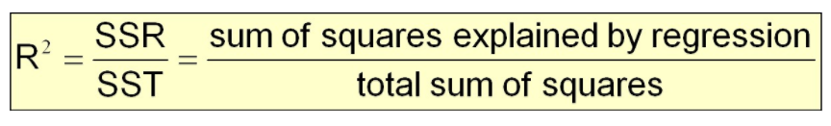
Coefficient of Determination (R-squared)
R-squared is a statistical measure of how close the data are to the fitted regression line or the proportional reduction in squared error due to the linear regression. The value shows how much of the variability in Y is explained by the model. If it is 0%, then none of it is explained by the model.
Here we compare our fit to a null model:
Y = a + ε,
where we don't use the independent variable X
We find the value for a based on the smallest ε.

Slide 45
Practical Tips [Review]
#add comments
How to find datasets: see library(help=“datasets”)
How to load data: see read.csv()
How to check current directory / change directory
getwd()
dir()
setwd()
(‘..’) to move up
How to save charts: see dev.copy() function, make sure to use dev.off() after publishing your plot
How to install packages
Generate z-scores: see scale() function
*Important* You must add interpretation to your results – only writing code supporting your analysis is not sufficient
I use TurnItIn – code copied from internet sources *will* be detected (please write your own original code)

